Slide 1

SQL Commands and Queries
A Total of 36 SQL queries have been successfully performed on the database.

Slide 2
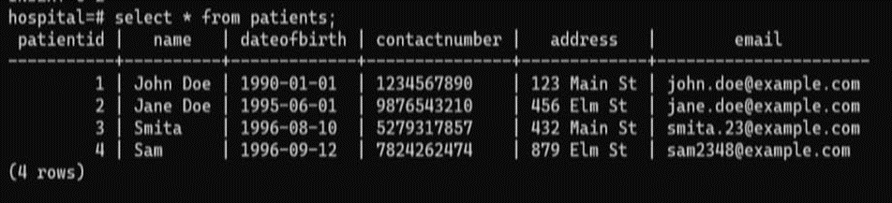
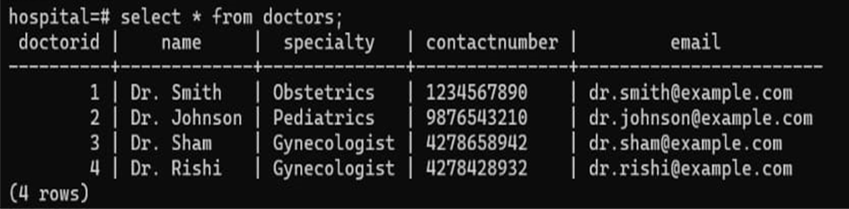
Patient Table
Doctor Table

Slide 3
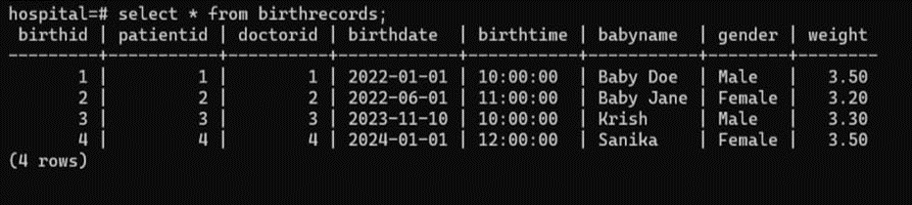
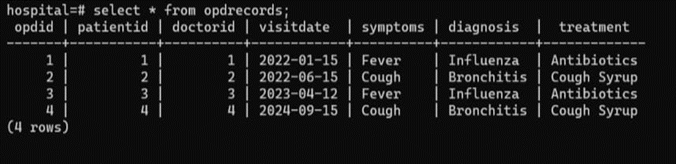
Birth Record Table
OPD Records Table

Slide 4
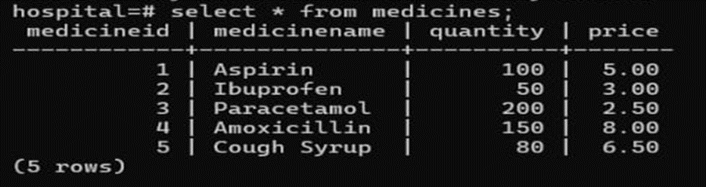
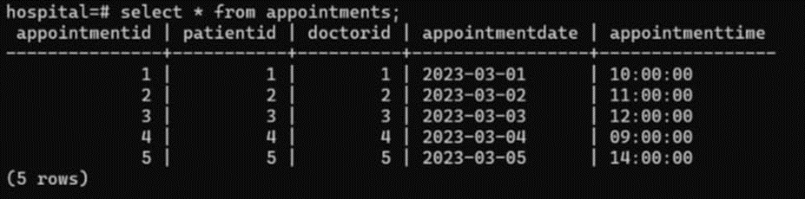
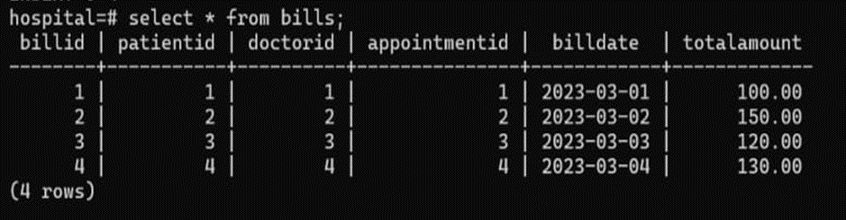
Medicines Table
Appointment Table
Bill Table

Slide 5
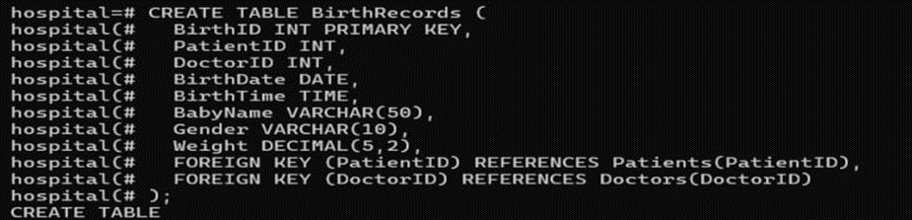
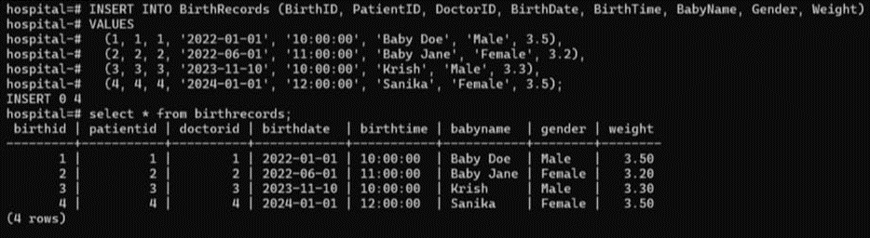
Basic Commands ( CREATE, INSERT, SELECT , DROP ):
Create table Birth Records.
Insert into Birth record table.

Slide 6
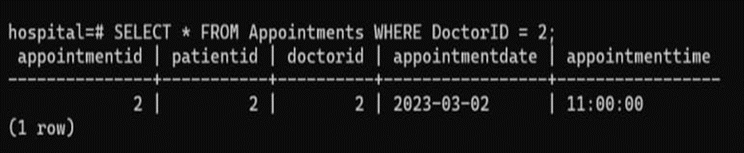
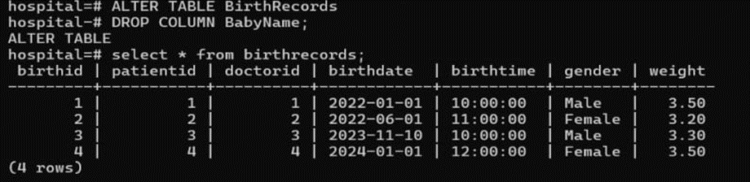
Elect from Appointment table where Doctor id is 2.
Drop the column baby name from Birth records table.

Slide 7
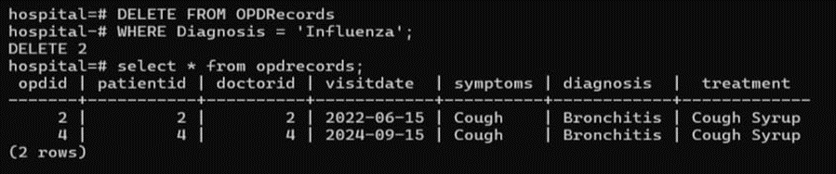
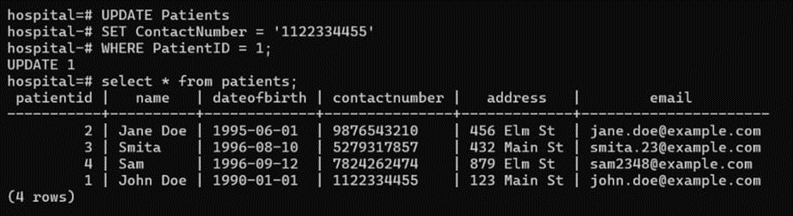
2. Modifying Commands (DELETE , UPDATE, ALTER , RENAME):
Delete from OPD records table where the patient has been diagnosed with Influenza.
Update the Patients Contact number whose Patient id is 1.

Slide 8
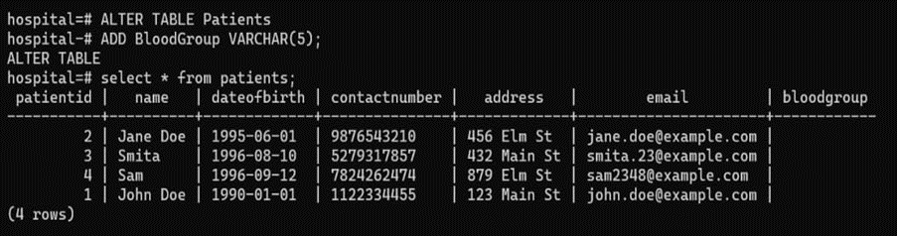
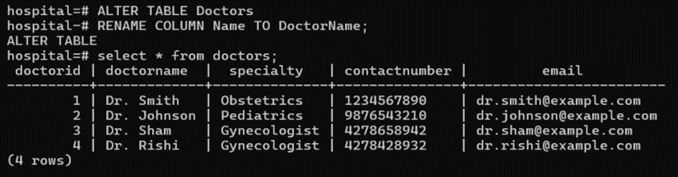
Alter Patient table to add a column of bloodgroup.
Rename the column name in doctor table to doctor name.

Slide 9
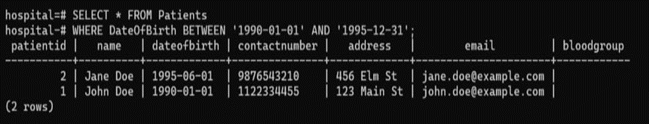
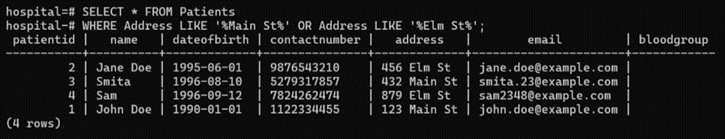
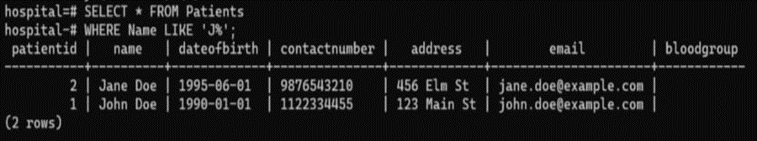
3. Compound Conditions (BETWEEN , AND , OR, LIKE, NOT LIKE).
..
Find all the patients whose Date of Birth is between 1990 and 1995.
Find the patient id whose weight is greater than 3.0 AND gender is male.
Find all patients whose name starts with J.

Slide 10
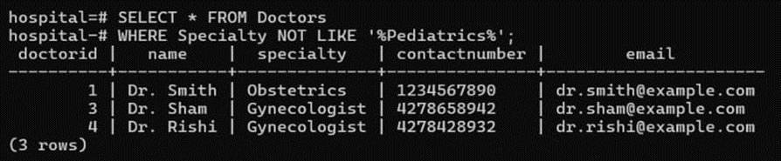
Find all doctors whose speciality does not contain Pediatrics.

Slide 11
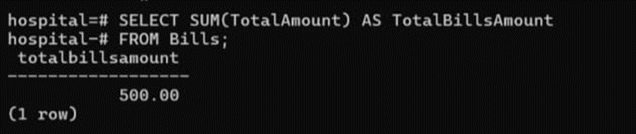
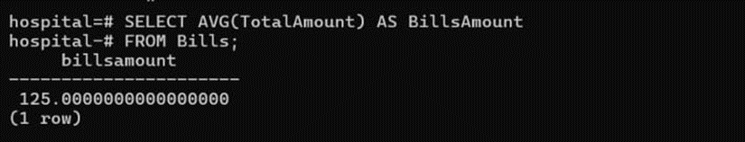
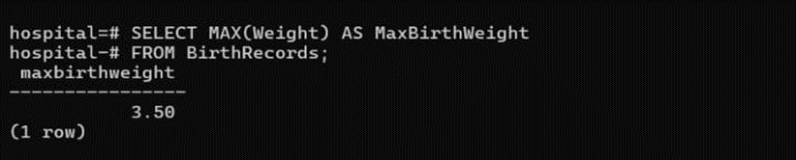
4. Aggregate Functions ( SUM, AVERAGE, MAX ,MIN, COUNT )
Calculate the total billing amount for all patients.
Find the average of total amout from the bills amount table.
Find the maximum weight in the Birth records table.

Slide 12
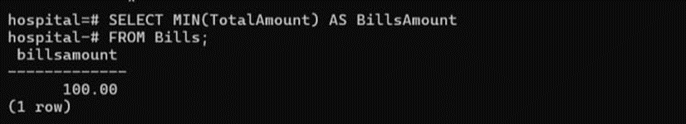
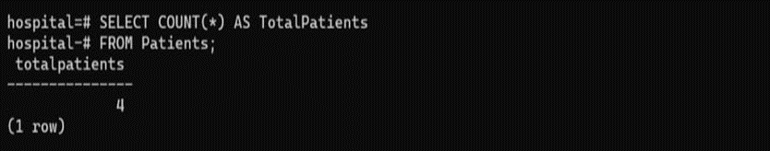
Find the minimum billing amount in the billing table.
count the total number of patients from the Patient table.

Slide 13
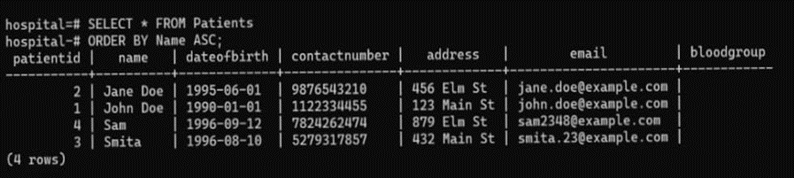
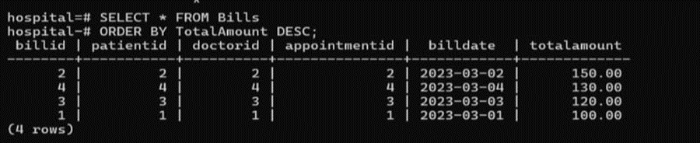
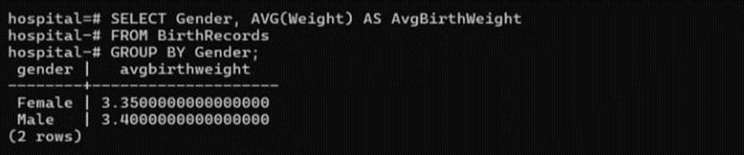
5. GROUP BY & ORDER BY :
List all patients ordered by their name in ascending order from Patient table.
Sort the total amount from bill table in descending order.
Group the birth records by gender and calculate the average birth weight for each gender.

Slide 14
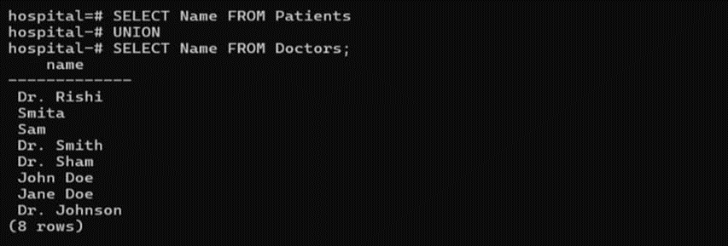
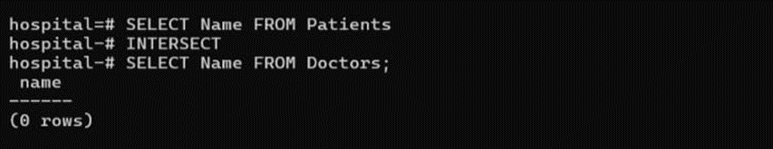
6. UNION , INTERSECT & MINUS:
Combine records from two tables, e.g , retrieve names of both patients and doctors.
Find patients and doctors who have the same name.

Slide 15
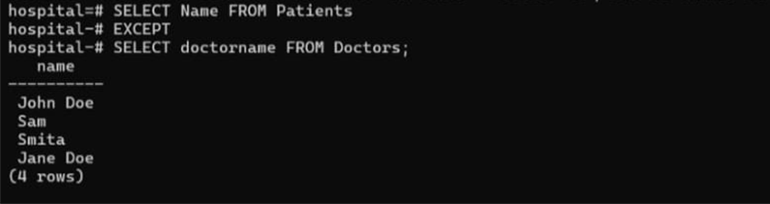
Find patients whose names are not listed as doctors.

Slide 16
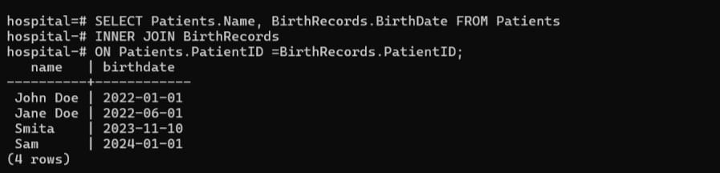
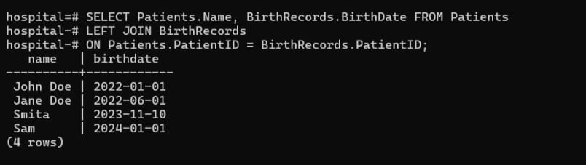
7. JOINS ( INNER , LEFT , RIGHT , FULL OUTER ) :
Retrieve patient names and birth dates for those who have a matching birth record.
Retrieve all patient names and their birth dates, including patients without birth records.

Slide 17
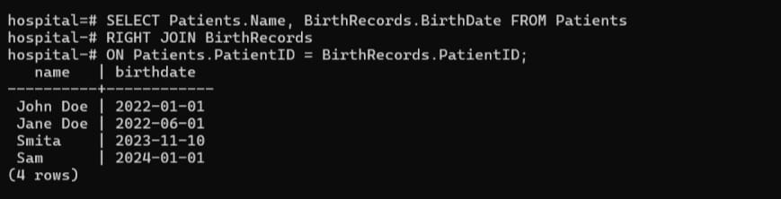
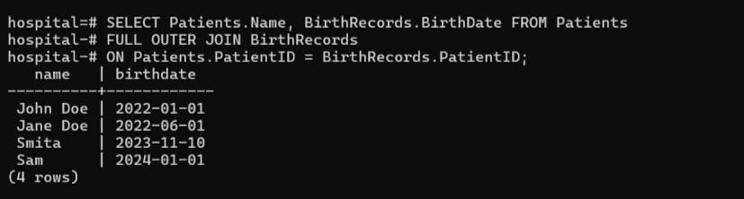
Retrieve all birth records and their corresponding patient names, including birth records without matching patients.
Retrieve all patient names and birth dates, including those without matches in either table.

Slide 18
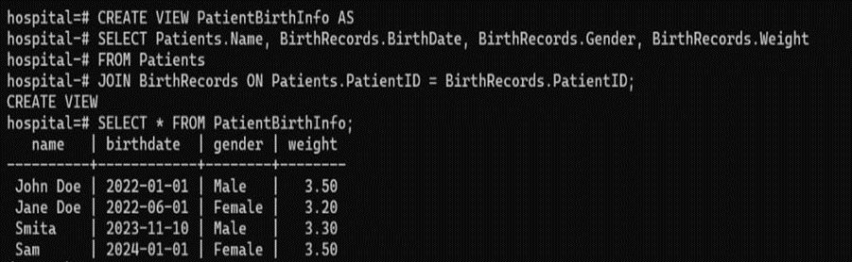
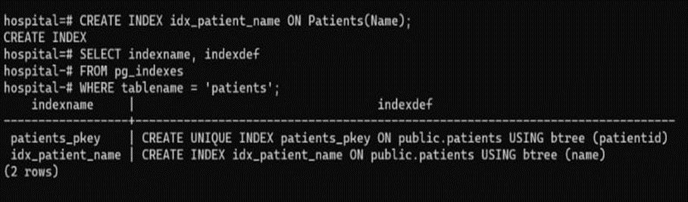
8. VIEWS :
Create a view that shows patient names, their birth details .
9. INDEXEX :
Create an index on the Patients table for faster searching by name.

